Slide 1
Nordonia Band Program
Through respect, community, and musical excellence, we strive to create a positive and inclusive environment where students grow as musicians, leaders, and well-rounded humans
2025-2026 Kickoff Meeting
Tuesday June 3rd

Slide 2
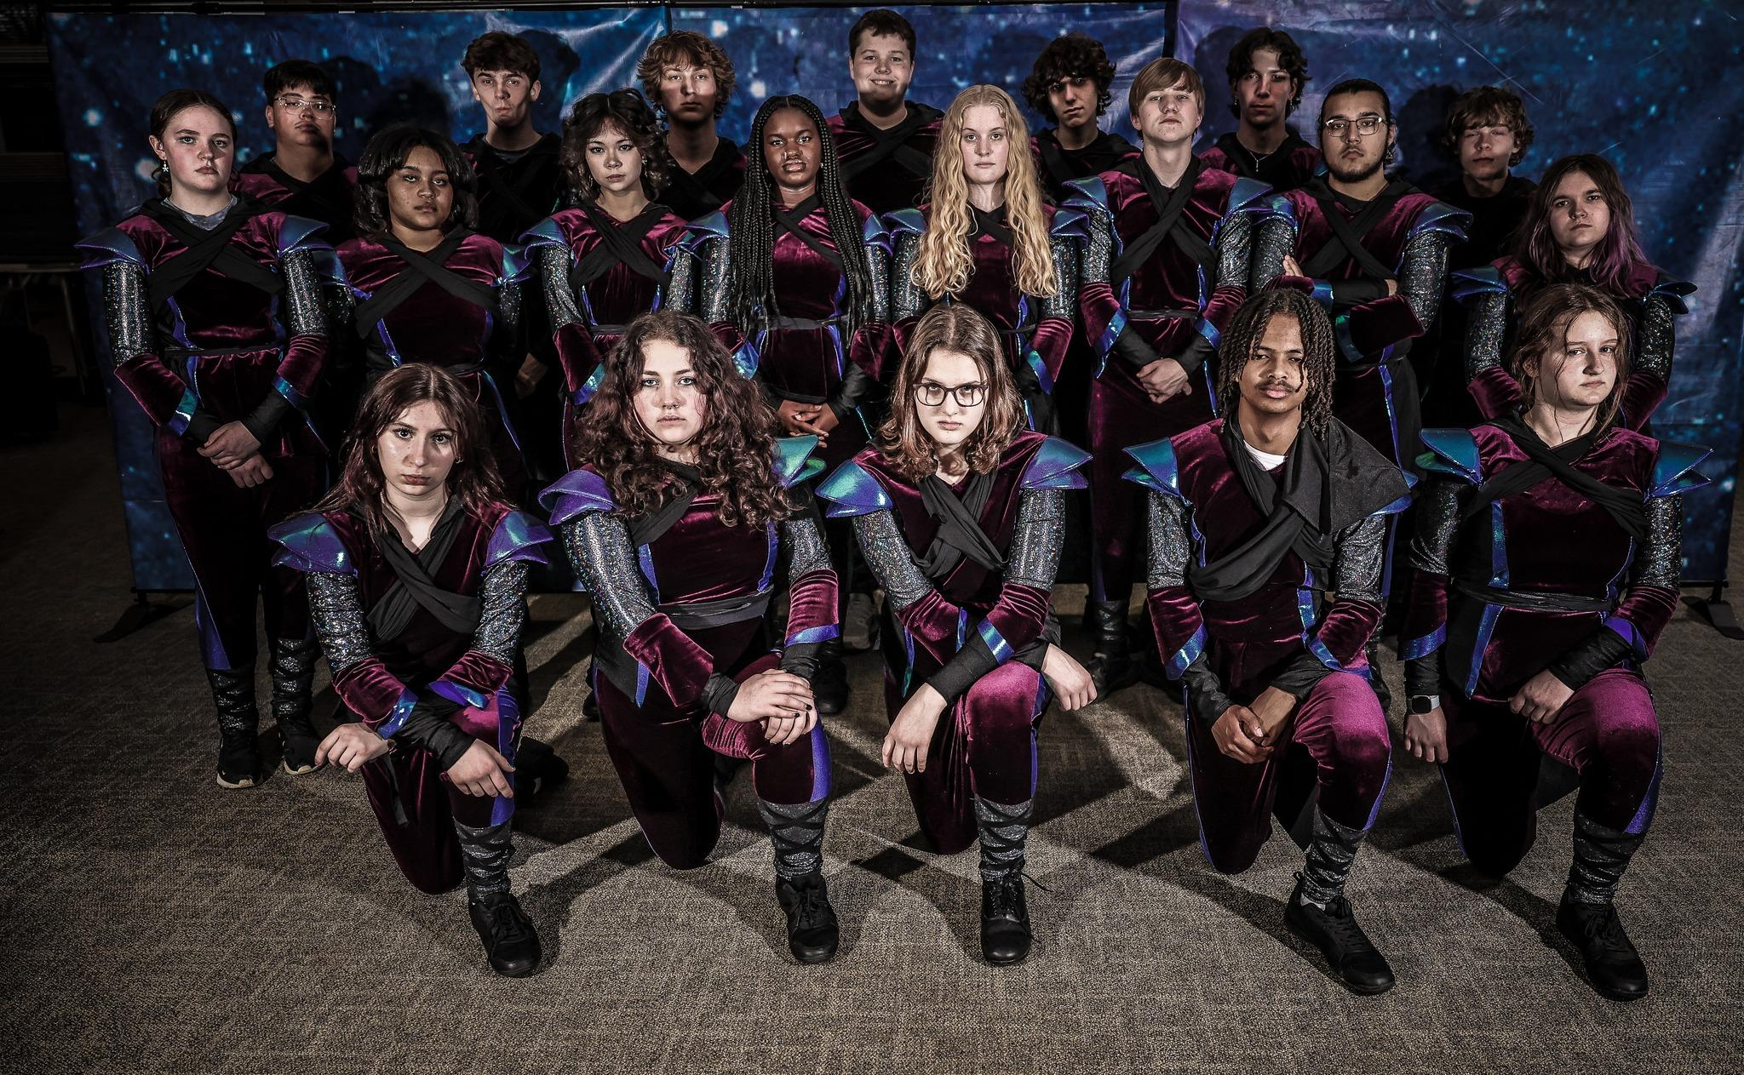
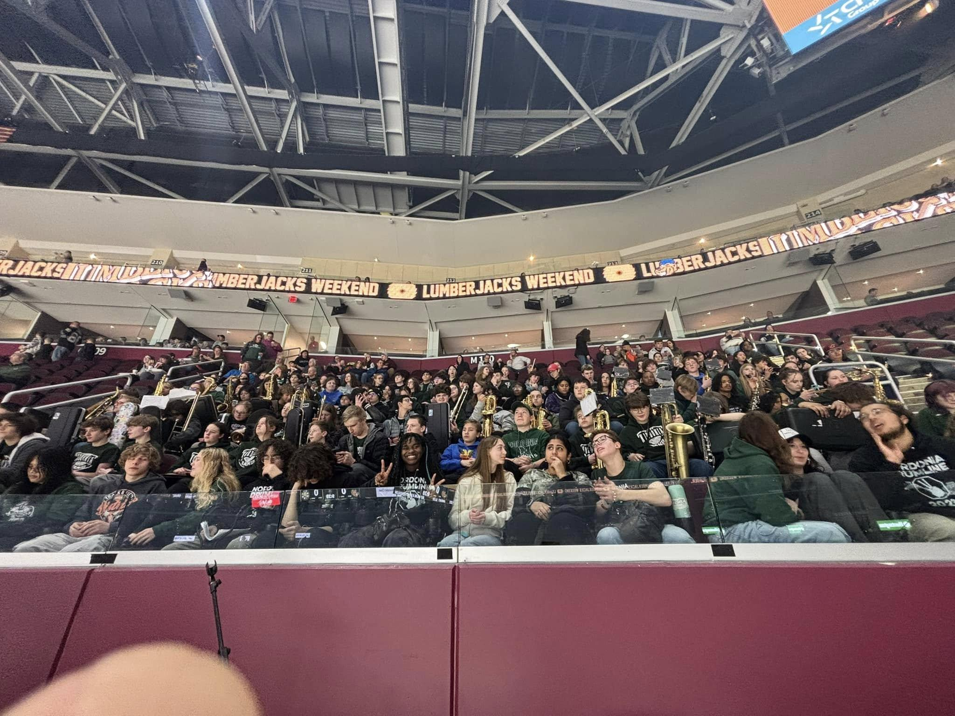
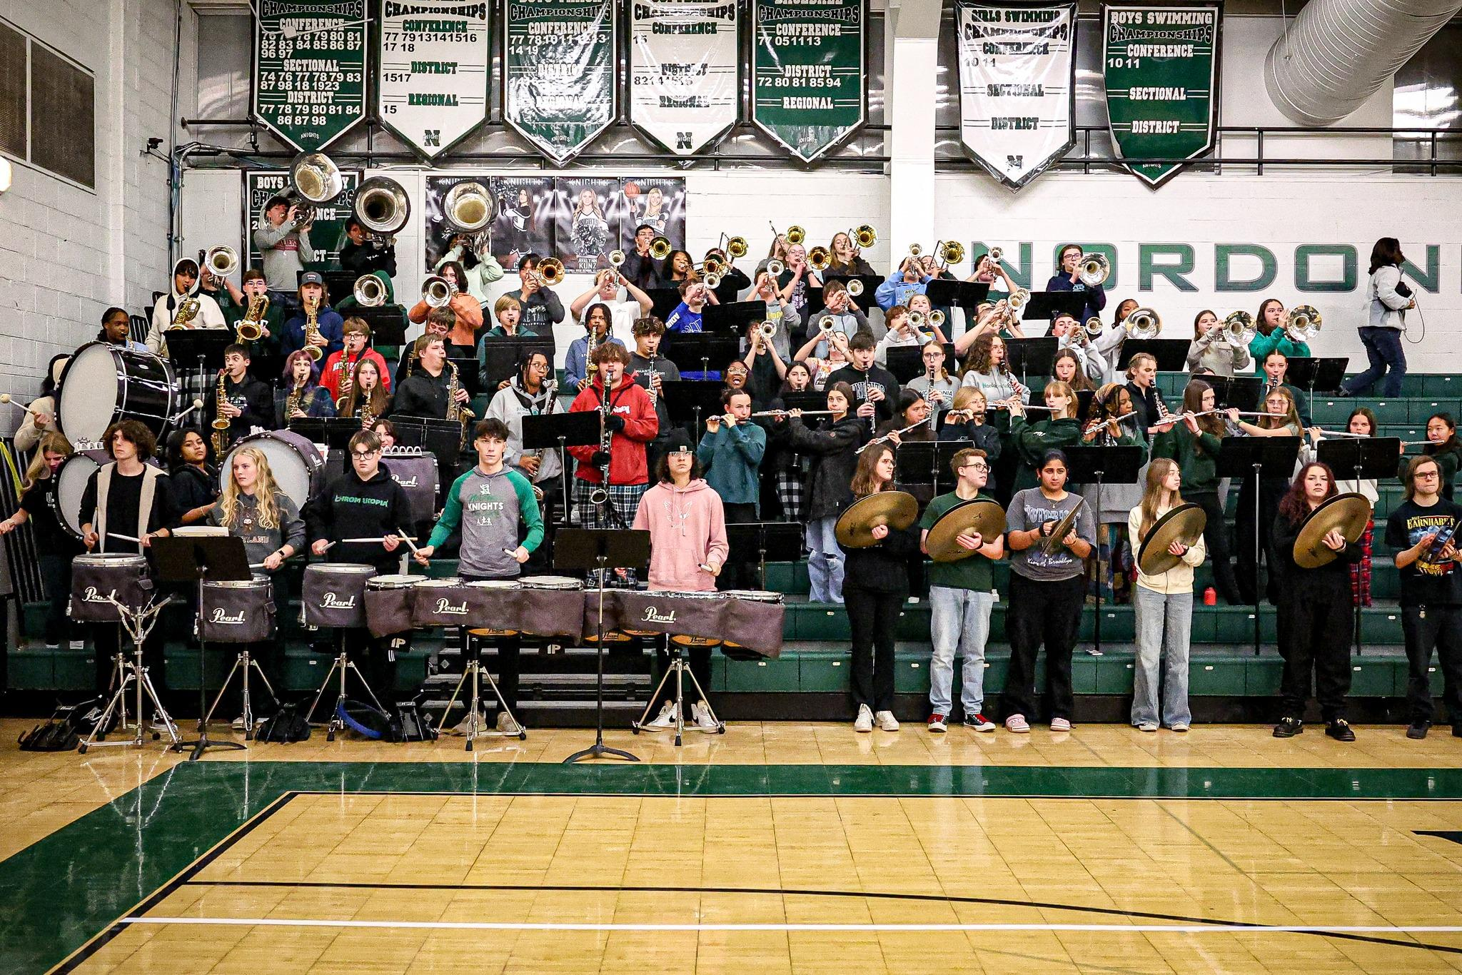

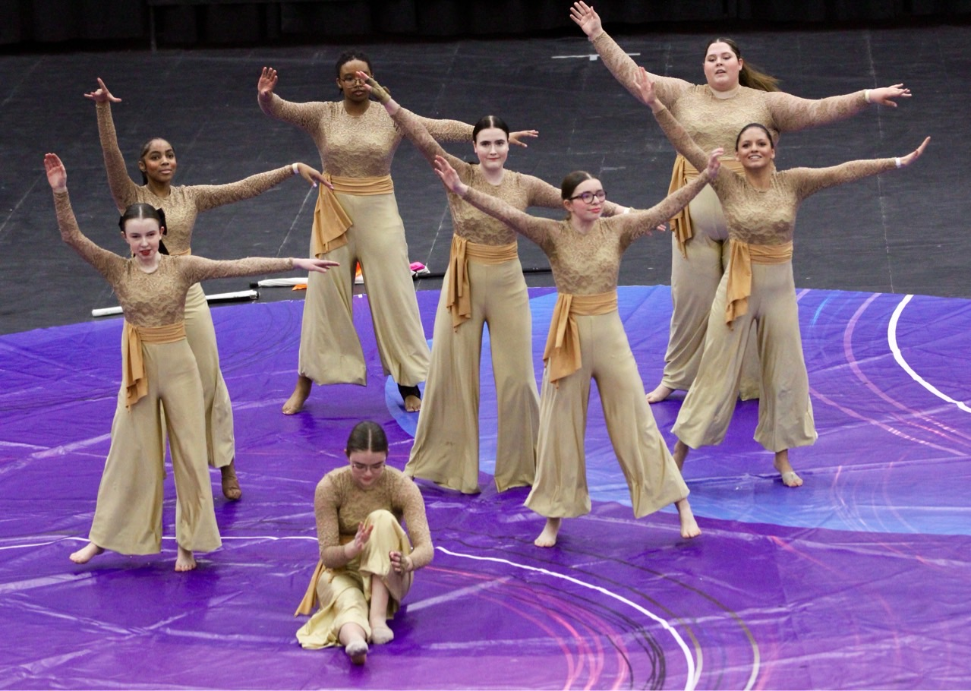
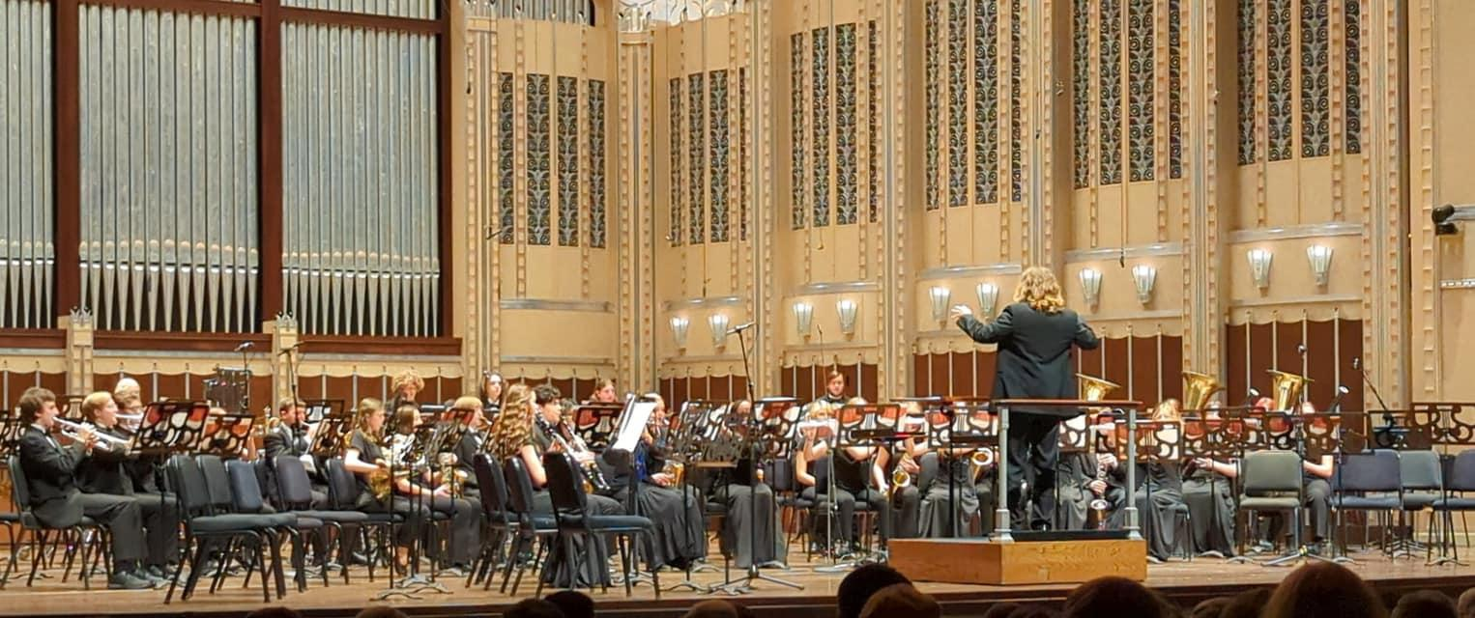
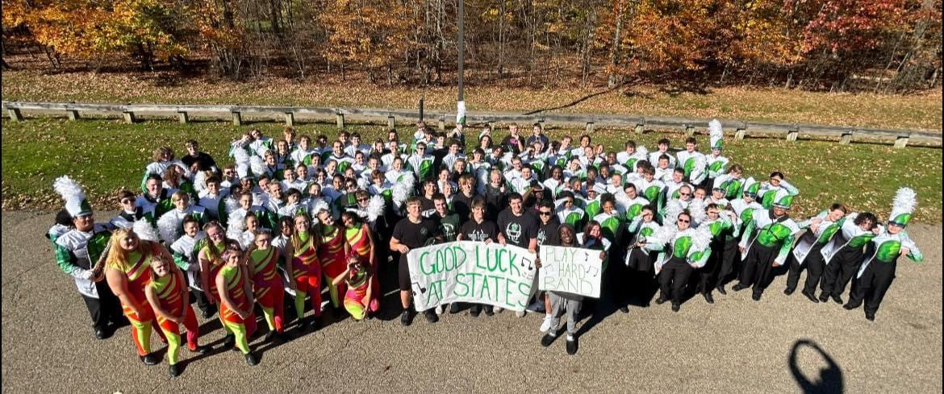

Slide 3
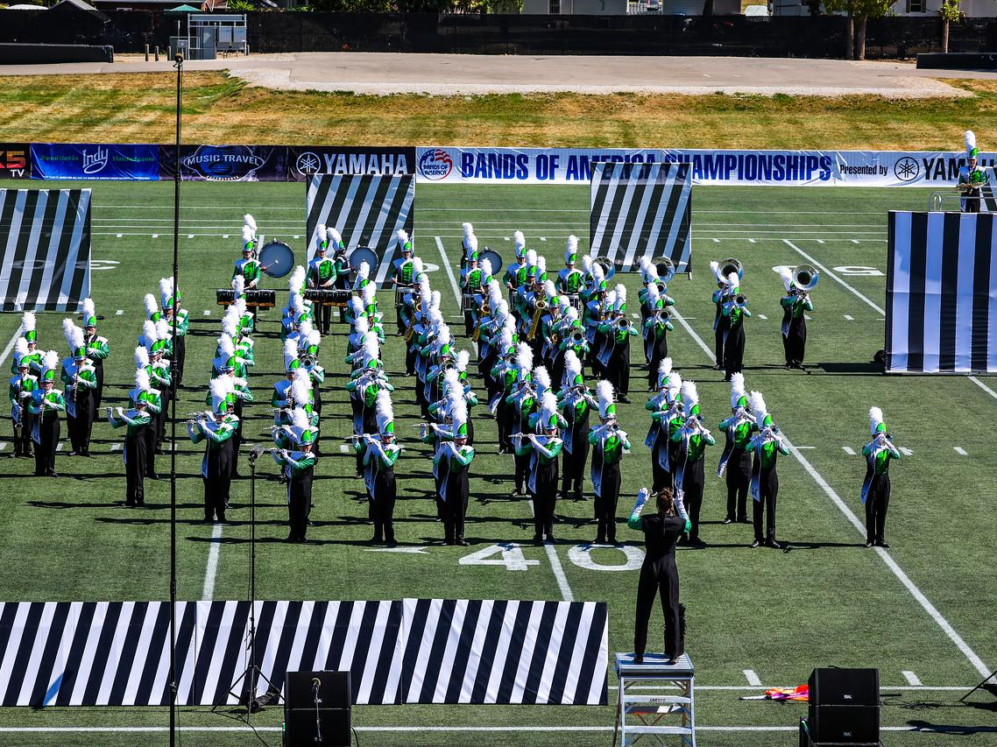
Nordonia Band Program
Investing in our students - Skills for a lifetime
Music
Goal setting
Organization
Team Work
Prioritization
Confidence
Leadership
Physical Fitness

Slide 4
NEW DIRECTOR SLIDE HERE

Slide 5
“The Team”
Educational Staff and Instructors
Directors
Eric Vasquez and
Associate Marching Band Director
Bernie Williams
Brass Staff
Emily Nestelle (and visual)
Chris Nestelle
David Abbuhl
Woodwind Staff
William Walker
Elijah Ondrish
Percussion Staff
Alfredo Smith
Ian Ko
Lucas Talent
Jaxon Stevens
Daniel Holm
Color Guard
Lauren Bradshaw
Lindsey Chapman

Slide 6
Marching Band Program Standard Performances
Friday Night Football Games
Competitions
Ohio Music Education Association – OMEA
District Level
State Level
Parade
Memorial Day
School Functions
Pep Rallies

Slide 7
Purpose of Summer Rehearsals
Skill Development: Establishing a strong foundation in marching fundamentals and music performance.
Show Preparation: Learn the music and drill for the upcoming season.
Team Building: Strengthen connections among band members to foster unity and trust.
Setting Expectations: Establish routines and standards for the rest of the season and year.
Ultimate DrillBook App on their smartphones.

Slide 8
Health, Safety & Wellness
Hydration & Nutrition:
Bring a refillable water bottle to all rehearsals.
Stay hydrated throughout the day, not just during practice.
Eat balanced meals to maintain energy and focus.
Physical Preparation:
GOOD Tennis Shoes ONLY. NO sandals, crocs, flip-flops, etc...
Apply sunscreen (and bug spray) and wear a hat or sunglasses during outdoor rehearsals.
DEODORANT!!!
Physical Training:
Gym Credit Waiver

Slide 9
Materials for Summer Rehearsals
Reusable Water Bottle - not single use
Instrument + Music or Guard Equipment
3 Ring Binder with at least 20 Plastic Slot Page Protectors (not needed for colorguard)
Pencil Pouch with multiple pencils
Towel for Physical Training and Stretching

Slide 10
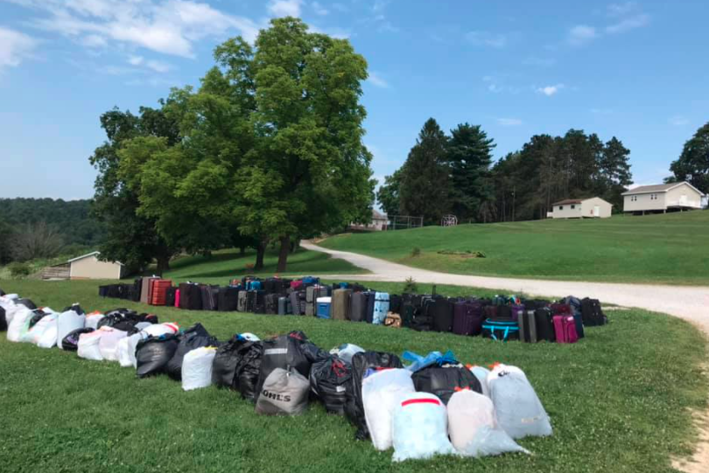
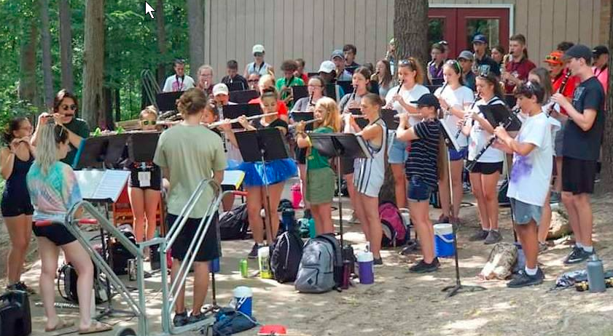
Away Band Camp
Skyview Ranch July 27th – August 1st
Intensive training program for marching band members.
Focus on music, marching technique, and ensemble performance.
Team-building activities to foster camaraderie.
Physical conditioning to build endurance and stamina.
Opportunities for student leadership development.
Encouragement of parent involvement and support.
Emphasis on creating a positive and inclusive learning environment.
An opportunity for students to form friendships and continue to be a part of the band community.
‹#›

Slide 11
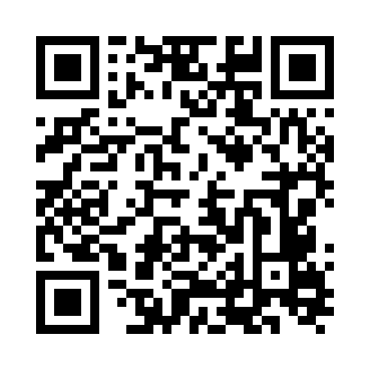
BAND App - Main Communication

Slide 12
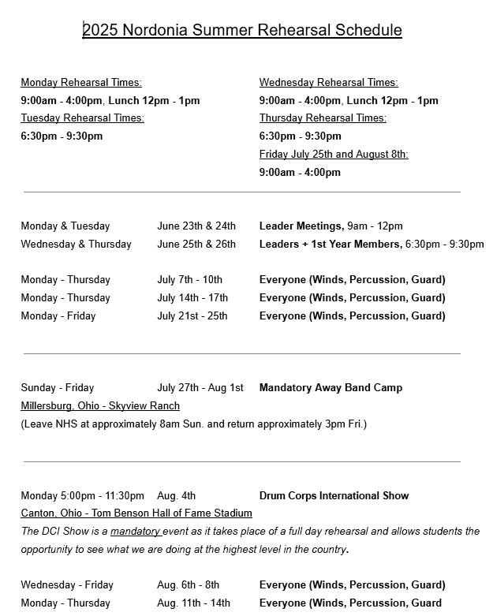
Summer Schedule

Slide 13
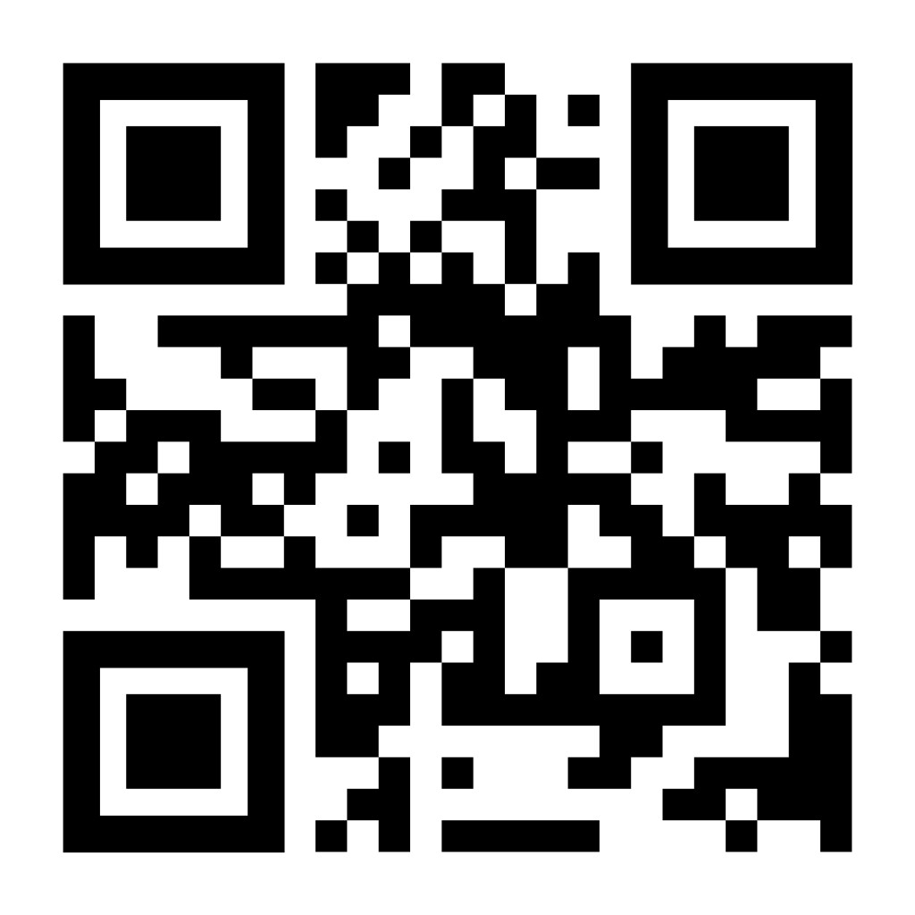
Attendance
Report times are communicated via the BAND App, NordoniaBands.org website, email and Facebook
Early is on time and on time is late!
Scheduling - Reduction of 100 Summer Hours
Avoid appointments during band rehearsals / events if possible
Minimize conflict with family vacations as much as possible
Provide employers with band schedule
Summer Absence Form:
Report absences ahead of time
https://forms.gle/1ArbV7qyCvZw53QD6
Submit each absence separately

Slide 14
Attendance School Practices / Events
Identify/resolve scheduling conflicts with other school activities at least two weeks in advance
Make every effort to be at both activities for the maximum time possible
Performance or game takes precedence over a practice or meeting
If both activities have practices, split missed time equally with agreement from both directors and/or coaches
In the event you can’t find a solution, work with directors and/or coaches to agree on which place you are needed more

Slide 15
Attendance & Grading
Marching Band is not just an activity, it is an extension of the classroom. Rehearsals and performances are required components of our curriculum.
Attendance and participation in rehearsals and performances make up a significant portion of students' grades for 1st and 2nd Quarter. Unexcused absences will result in a loss of points.
*NEW for 2025* - Attendance and participation in marching rehearsals and performances will influence ensemble placement and seating assignments for Concert Band and Wind Ensemble.

Slide 16
What’s To Come After Marching Season is Over…
Wind Ensemble and Concert Band
Auditions
Winter Arts Festival
Monsters Game Performance
OMEA Large Group Contest
All District Concert
Jazz Festival/Jazz Club - New!
Extra-Curricular Ensembles
Chamber Ensembles
Indoor Drumline
Indoor Winterguard

Slide 17
Nordonia Band Aides
Non-profit and non-political organization whose purpose is to increase the interest of the community in the instrumental music programs of the Nordonia schools
Qualifying Members
Anyone, 21 years of age or older, interested in the progress and development of the instrumental music program of the Nordonia Schools is eligible for membership
Parents of students in the instrumental music department shall be considered active members
No dues
Monthly meetings typically the first Monday during the school year

Slide 18
Nordonia Band Aides
Parent Meetings
Mondays @ 7:00 PM (unless otherwise noted)
Location: High School IMC
2025
Mon 9/8
Mon 10/6
Mon 11/10
Mon 12/8
2026
Mon 2/2
Mon 4/6

Slide 19
Band Aides Executive Committee
Role | Name / Email | Band Members
President | Esther Gotfryd president@nordoniabands.org | 12th - Battery/Percussion 11th - Trumpet
Vice-President | Carl Newyear vicepresident@nordoniabands.org | 12th - Drum Major 10th -Trumpet
Treasurer | Kathi Fox treasurer@nordoniabands.org | 12th - Trombone
Assistant Treasurer | Anthony Trivisonno asst.treasurer@nordoniabands.org | 10th - Trombone/Baritone
Secretary | Jennifer Lupica secretary@nordoniabands.org | 10th - Trumpet
Fundraising Coordinator | Andrea Anderson fundraising@nordoniabands.org | 12th- Trumpet
Volunteer Coordinator | Vicki Vachon-Seager volunteercoordinator@nordoniabands.org | 10th - Percussion/Front Ensemble
Marching Band Coordinator | Stacey Newyear marchingband@nordoniabands.org | 12th - Drum Major 10th- Trumpet
Marketing Coordinator | Ilya Gotfryd marketing@nordoniabands.org | 12th - Battery/Percussion 11th- Trumpet
Special Events Coordinator | Tiffany Taylor events@nordoniabands.org | 11th - Color Guard

Slide 20





Parent Communication
Tool | Access Information | Purpose
 | cheddarup.com | make monthly payments
 | https://band.us | Calendar Quick updates/reminders Notification of pickup times
 | https://www.facebook.com Closed Groups: ⧫2025/26 Nordonia Bands ⧫Nordonia Band Aides | Positive promotion Band Program Quick updates/reminders Notification of pickup times
 | https://www.nordoniabands.org | Positive promotion Band Program Calendar Media Archive Booster Information

Slide 21
Parent Communication
Resources when online tools are not helping
Parent Section Leader
Executive Board Committee Member
Treasurer or Asst. Treasurer for payment questions
Volunteer Coordinator or MB Coordinator for any volunteer questions
Unsure who to talk to?
Contact President - president@nordoniabands.org
Contact V.President - vicepresident@nordoniabands.org
Please feel free to call or text me with any questions - Esther Gotfryd (President) 216-246-9430

Slide 22
Parent Section Leaders
Section | Parent Leader | Phone Number
Color Guard | Dawn Sedor | 216-778-0156
Percussion | Michele Natali | 330-697-8496
Flute/Clarinet | OPEN
Saxophone | Allison Lehman | 216-401-8749
Trumpet/Mello | Ken & Beth Barhoover | 330-219-1824
Low Brass | Missy & Doug Nelson | 216-867-4970
Responsibilities:
Make contact with all families within the section and assist with new family questions and needs
Coordinate/assist with optional section spirit wear
Coordinate section raffle basket themes and donations for fundraising events
Assist with volunteer recruiting to fill open positions
Reinforce/follow up on organization deadlines and reminders
Questions? Contact Carl Newyear-vicepresident@nordoniabands.org

Slide 23
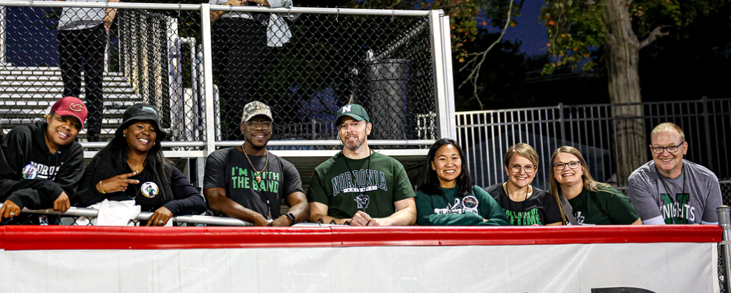
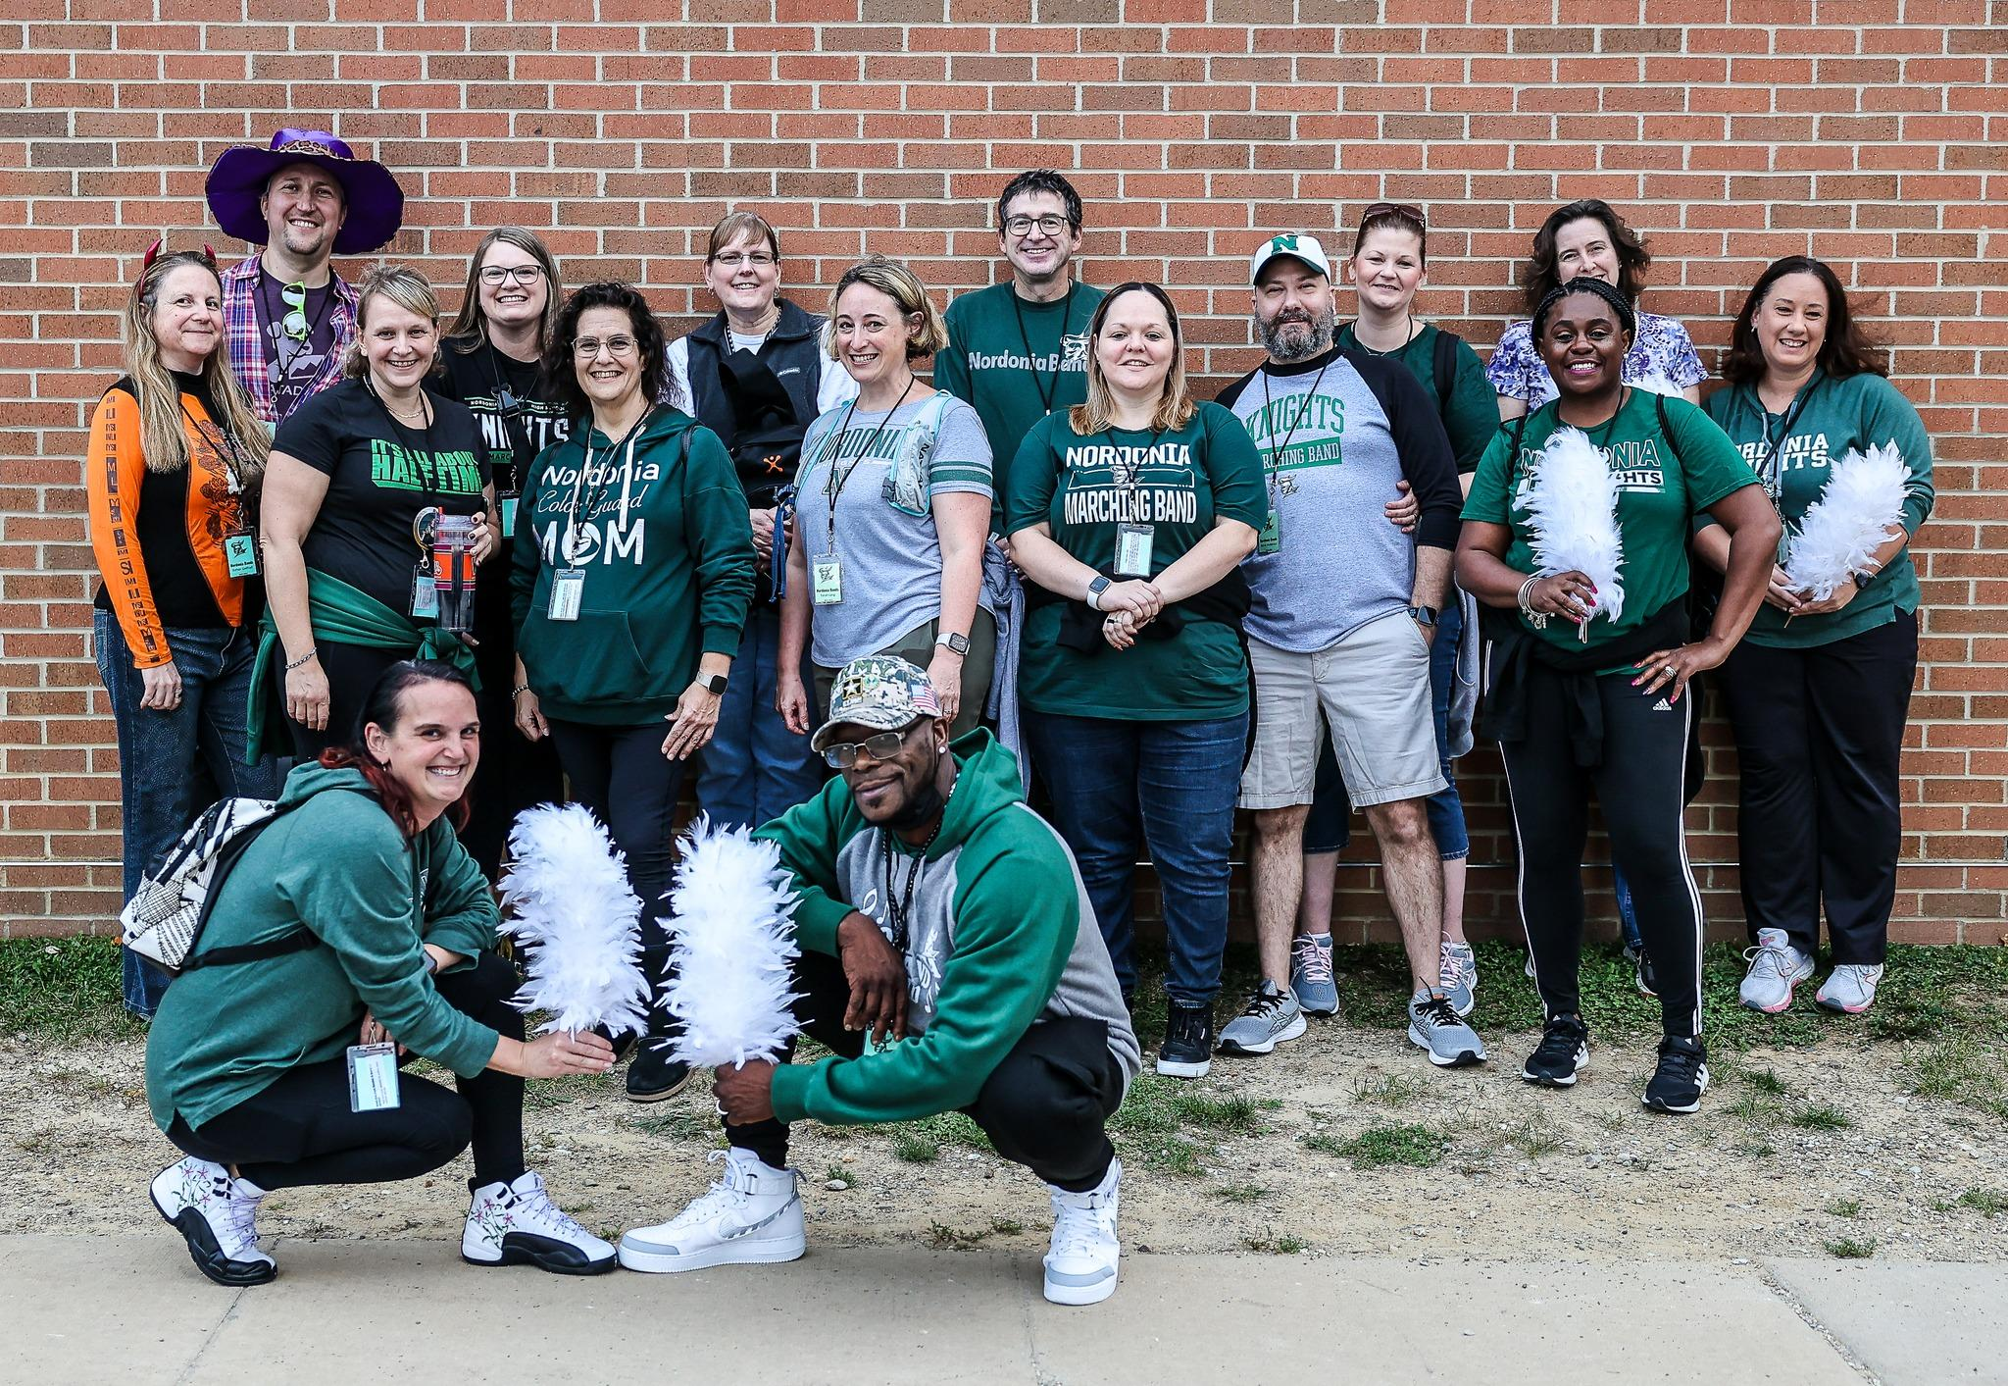
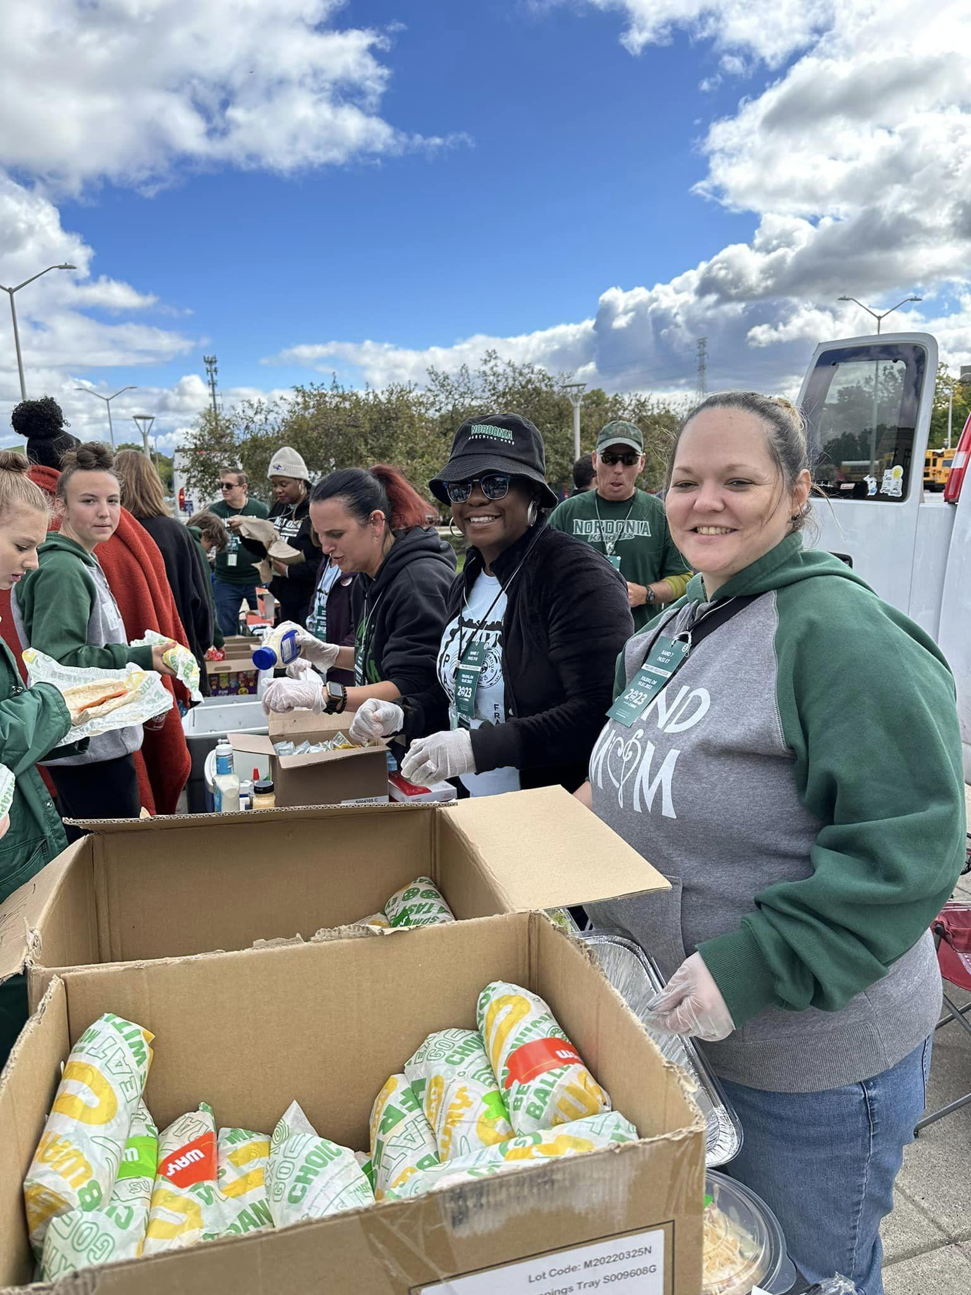
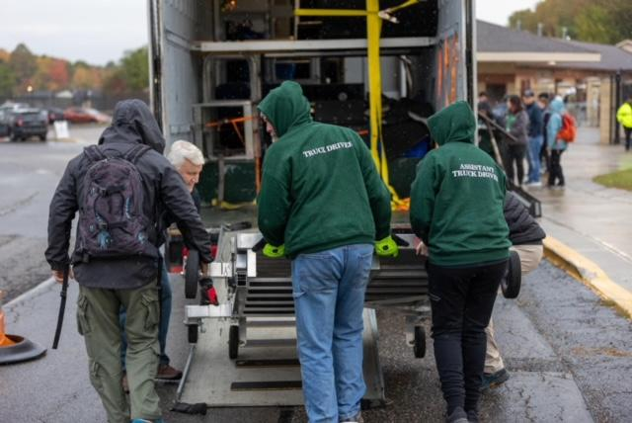
Nordonia Band Aides
Volunteering!
Volunteering-a great way to see what we do behind the scenes as well as meet new parents!
It truly takes a village to help a 130 member band. We would love EVERYONE to help in some capacity; please make time to help throughout the year
Our Goal: To get as many new parents involved as possible while maintaining a balance of chaperones with experience

Slide 24
Nordonia Band Aides Volunteer Coordinator Overview-
We utilize ‘Sign-Up Genius’ for all Nordonia HS Band events throughout the school year that require volunteers or donations. These links are communicated to parents/guardians via BEST email on file provided at beginning of the season
ALL Volunteer positions are to be filled by band parents/guardians FIRST
**If additional help is needed, then alumni or extended ADULT ONLY family members, age 18 and over, ‘may’ be considered depending on the role (pending Director approval)
**If volunteering please do not bring minor children not in the ensemble to the event
**volunteers need be 18+ years
Handy with tools? Tech Savvy? Crafty?
You may be able to help in a big way!
Please share how you might be able to help:
volunteercoordinator@nordoniabands.org

Slide 25
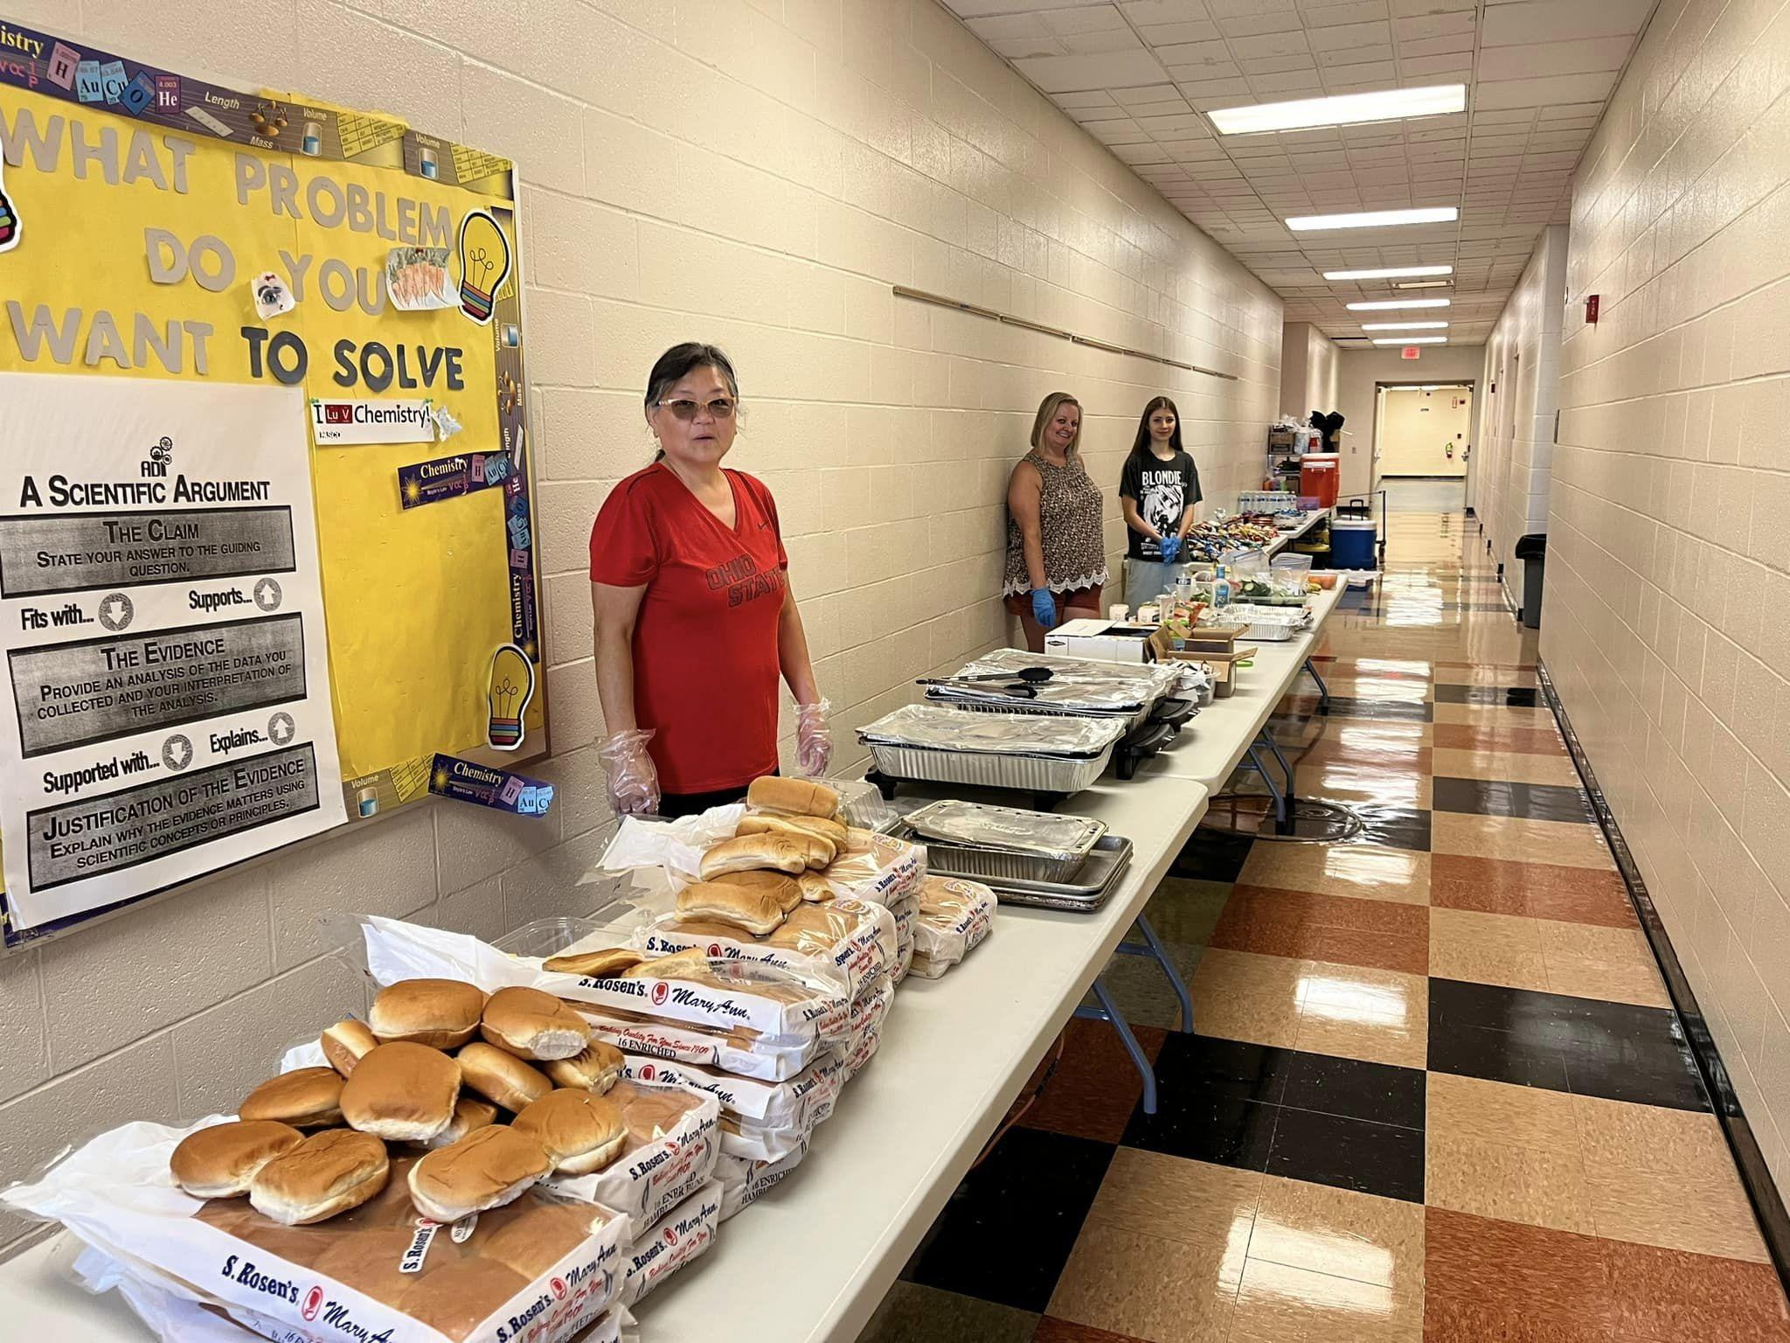
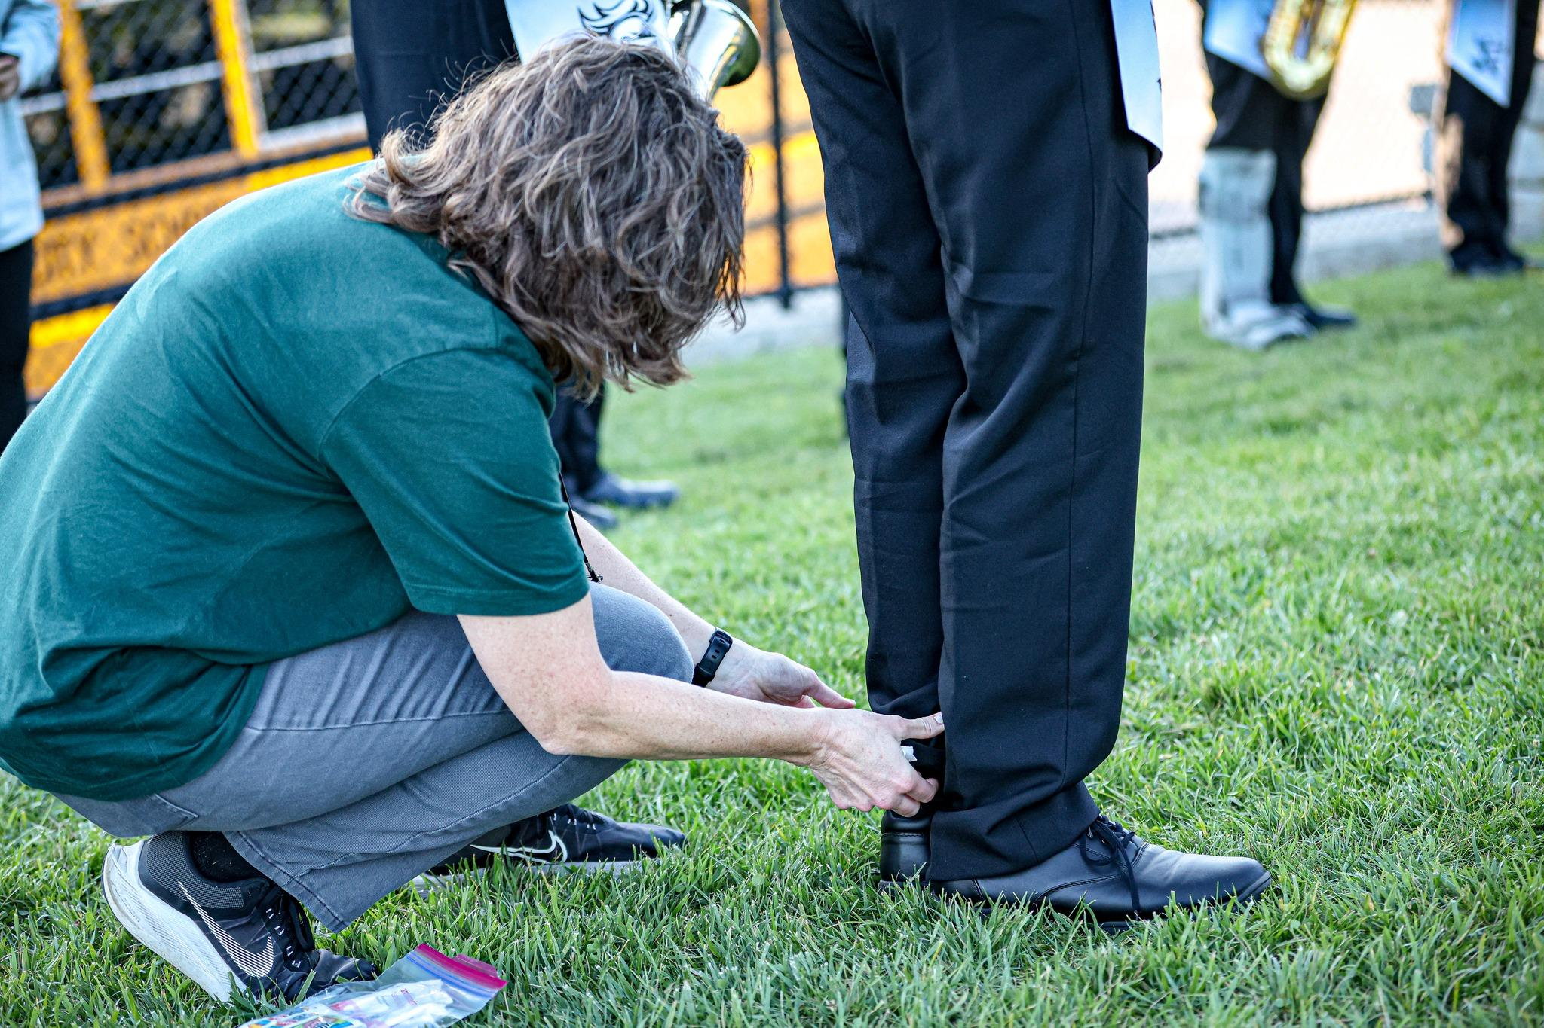
Nordonia Band Aides Volunteer Opportunities:
Summer/Fall 2025
Full Day Band Rehearsals
Summer Meal Committee
Uniform fittings
Chaperoning/Support Crew
DCI Show
Football Games
Competitions
Concessions
Fundraising(all throughout the year)

Slide 26
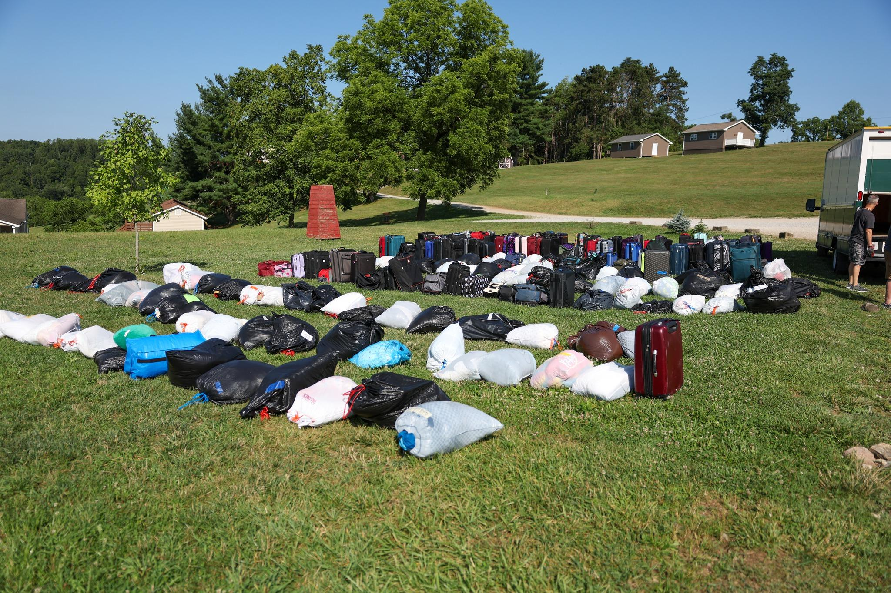
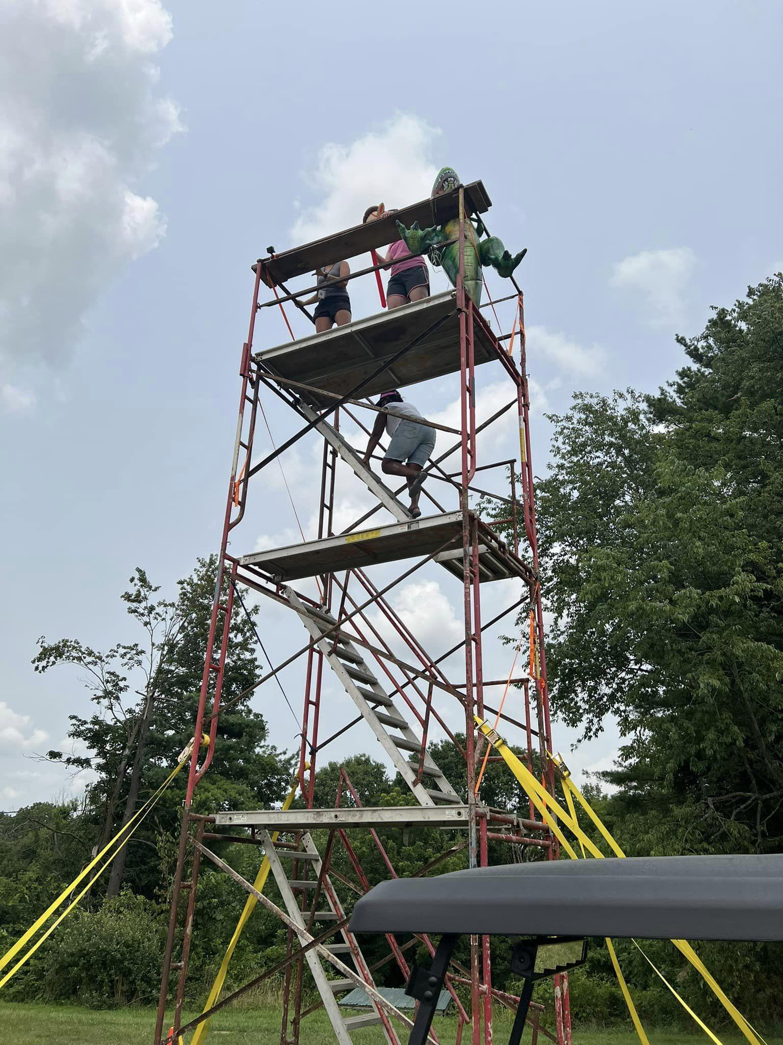
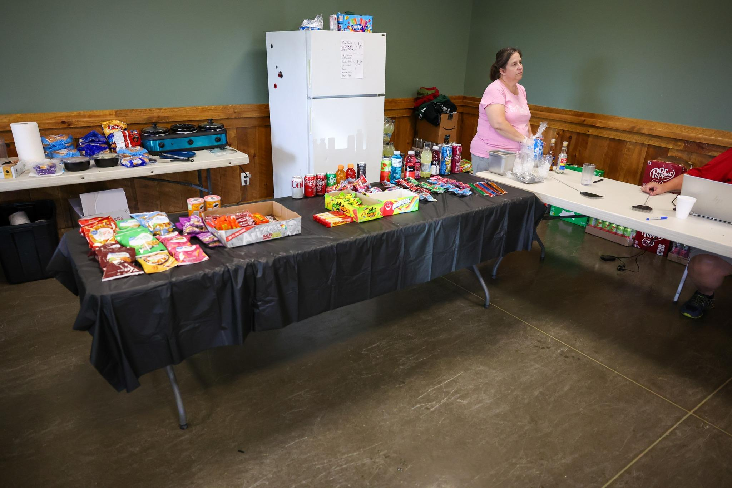
Nordonia Band Aides Volunteer Opportunities:
Band Camp
Set - Up (day before we leave)
Check-In, Medical & Baggage Check
Load/Unload the Truck
Bus Chaperone
To and From Band Camp
Camp Chaperone (Men & Women)
Full Week
Half Week*
Approved FBI/BCI check (via Nordonia)
Medical Chaperones
Snack Shack

Slide 27
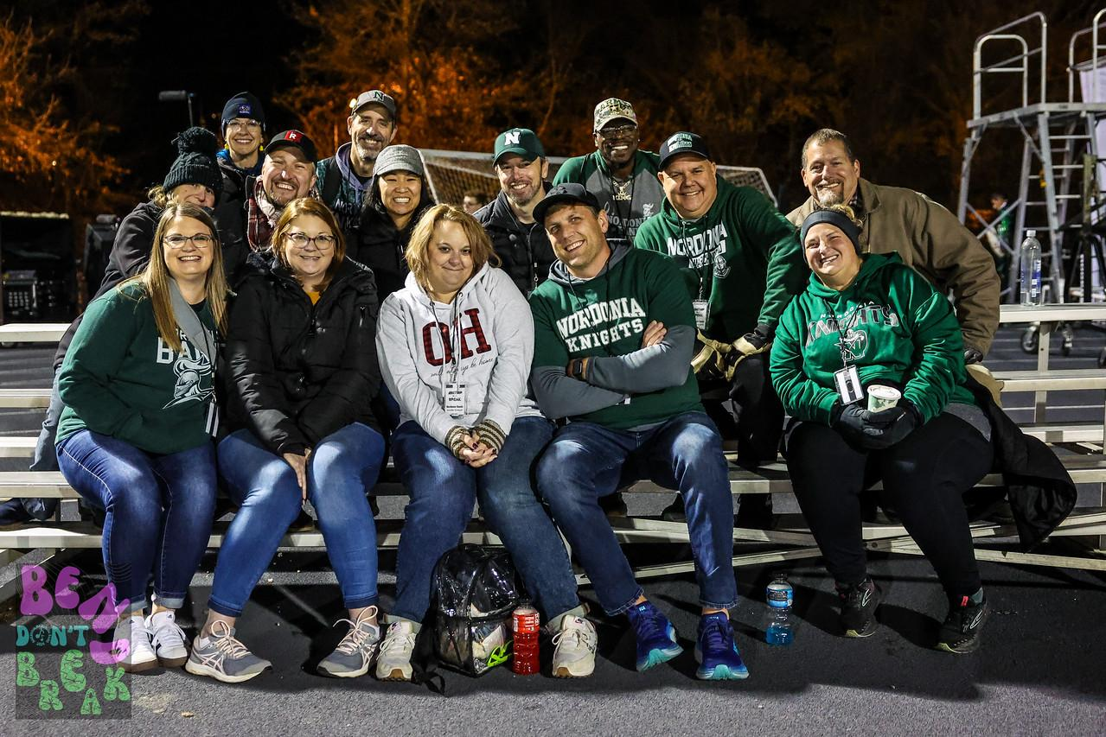
Nordonia Band Aides Volunteer Opportunities:
Football Games & Competitions
Chaperone – Away Events (Bus) & Home Events
Fundraising (Home Games)
Visitor Side Concession Stand
Krispy Kreme
Crumbl Cookie
50/50 Raffle
Medical Chaperone
Performance Support Crew
Uniforms
Load/Unload Truck
No Sign-Up Needed!
Media (Video & Photography)

Slide 28
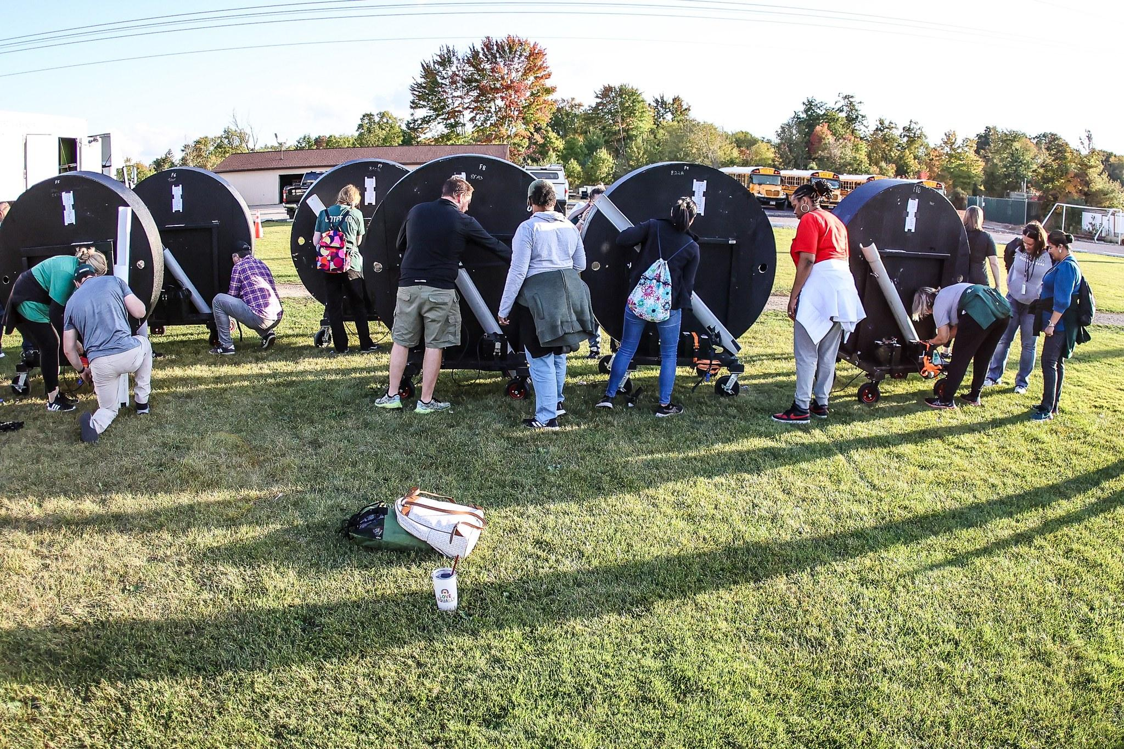
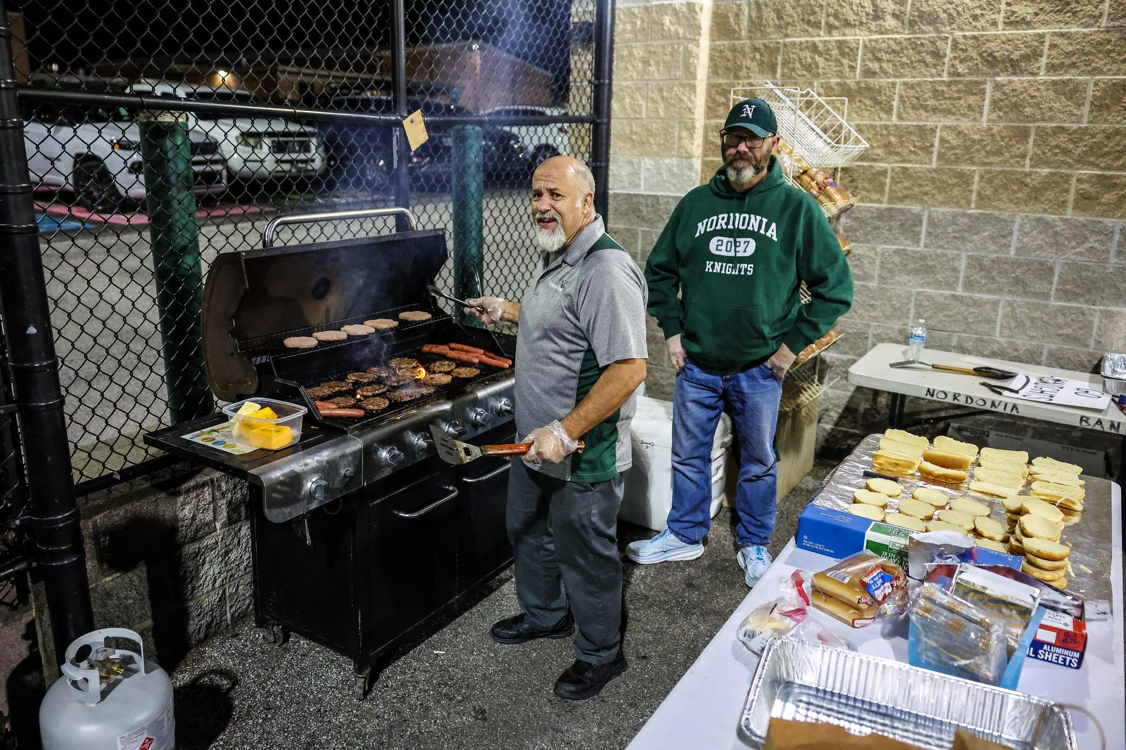
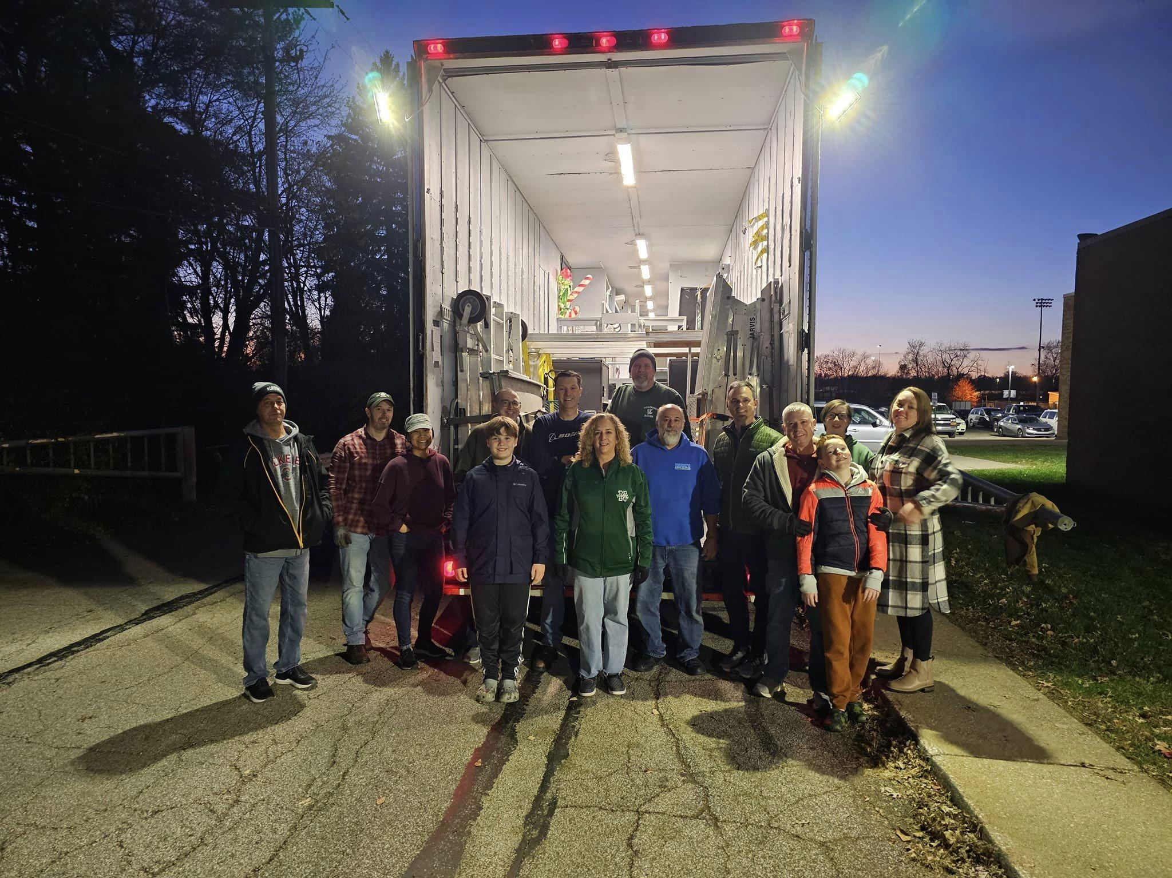
Nordonia Band Aides
A Little Perspective….
From August to early November:
approx 597 volunteer slots were fulfilled! Thank you!!

Slide 29
Marching Band Fees
Benefits paid for in part* by $875 fee:
Band Camp
Competition entry & meals
Ohio State University day trip/competition
Meals during all-day summer practices
Show shirt
Drum Corps International event
Uniform laundering
First Time Set-up costs paid by $100 Rookie fee: summer uniform, shoes, gloves, gig bag

Slide 30
Help with Fees and Costs
DO NOT STRESS OVER FEES/COSTS!!!
Reach out with concerns:
treasurer@nordoniabands.org or 440-465-0397
president@nordoniabands.org or 216-246-9430
Take advantage of:
RaiseRight - earn rebates on purchases of eGift Cards; use for groceries, fast food, coffee, etc.
Band Cards - earn $5 credit for every $10 card sold
Spring band calendar fundraiser
Consider helping others, if feasible:
Donate toward band fees - Go to: my.cheddarup.com/c/2025-band-donations (NBA is a 501(c)(3) charitable organization and donations may be tax deductible.)

Slide 31
Fundraising
FUNDRAISING IS ESSENTIAL
Successful fundraising reduces fees and supports all band functions; success depends on you!
Expenses not covered by fees:
Show costs - skilled instruction, design, music, flags and props
Senior night and year-end banquet and awards
Scholarships
Marketing for fundraisers and tag day
General expenses

Slide 32
Fundraising Facts
Fact #1: Fundraising starts with FUN! Volunteering is fun and a great way to get to know one another.
Fact #2: Anyone can lead or chair an activity. Pick something that interests you.
Fact #3: 84% of fundraising profit comes from 4 activities.
(Summer) Band Card Sales
(Fall) Home Football Games (visitor concessions, Krispy Kreme sales, Crumbl Cookie sales, 50/50 raffles)
(Winter) Knight at the Races (KATR)
(Spring) Spring Band Calendar fundraiser
Fact #4: Your participation is critical to our success.
Fun Fact #4:

Slide 33
TAG Day
TAG Day is MANDATORY for all students
August 23rd, 2025
TAG Day is our annual donation drive that is used to continually replenish our uniform fund.
Students will be sent door to door in small groups to reach out to the community for donations.
This event will require many adult volunteers to drive students around assigned neighborhoods.
Thank you in advance for your help!!! Details to be sent mid-summer

Slide 34
2025-26 Fundraisers
TAG Day- Mandatory August 23rd, 2025
Community Sponsorships (new ‘25-’26)
Band Cards - July 2025
*Band Fee credits earned
Home Football Games
(Visitor concessions, Krispy Kreme/Crumbl cookie sales, 50/50 raffles)
Honey Baked Ham Gift Card - Winter and Spring
Winter Arts Fest ‘Cookie Walk’ - Dec 2025
Super Bowl Squares - January 2026
Knight at the Races - March 2026
Spring Band Calendar Fundraiser - Spring 2026
*Band Fee credits earned

Slide 35
Band Fees and Financials
Payment options
Online by credit card (preferred), or e-check - Cheddar Up
Check made payable to Nordonia Band Aides Mail to: PO Box 560080, Macedonia, Ohio 44056 or drop the payment in the NBA drop box in the uniform room.
Date Due | Description | Amount | Applies to
May 15, 2025 | Band Fee Installment #1 | $175 | All students
Jun 1, 2025 | Band Fee Installment #2 | $175 | All students
Jul 1, 2025 | Band Fee Installment #3 | $175 | All students
Aug 1, 2025 | Band Fee Installment #4 | $175 | All Students
Sep 1, 2025 | Band Fee Installment #5 | $175 | All students
Nov 2025 | Concert Attire | $25-40 | New students/replacement
School Activity Fee
Paid to Nordonia Hills City Schools 2025 Band Activity Fee: $180.00 (via Payschoolscentral.com) *2025 Winter Guard / Winter Drumline Fee: $180.00*
Other Potential/Optional Costs: Concessions (football games/OMEA competitions), Picture Day, and Spiritwear

Slide 36
2025 Show Trailer

Slide 37


Wrap Up Questions and Answers

